Slide 1

UN Treaty on the Prohibition
of Nuclear Weapons 2017
SIGNATURE AND RATIFICATION

Slide 2
The Treaty on the Prohibition of Nuclear Weapons opened for signature at United Nations Headquarters on 20 September 2017.
It will enter into force 90 days after the fiftieth instrument of ratification, acceptance, approval or accession has been deposited.

Slide 3
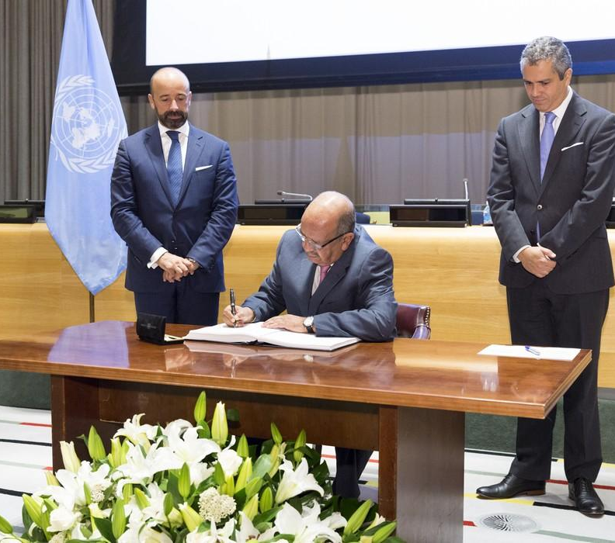
Algeria
H.E. Mr. Abdelkader Messahel, Minister for Foreign Affairs
SIGNATURE
20 SEPTEMBER 2017

Slide 4
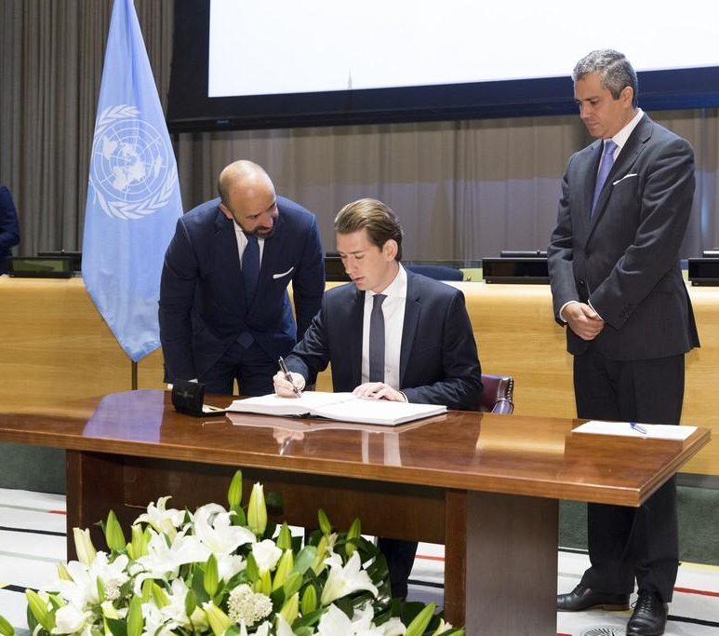
Austria
Mr. Sebastian Kurz, Minister for Foreign Affairs
SIGNATURE
20 SEPTEMBER 2017

Slide 5
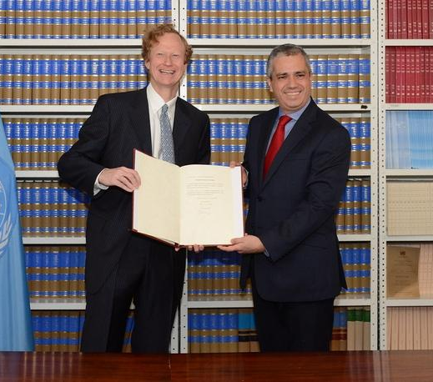
Austria
H.E. Mr. Jan Kickert, Permanent Representative to the United Nations
RATIFICATION
8 MAY 2018

Slide 6
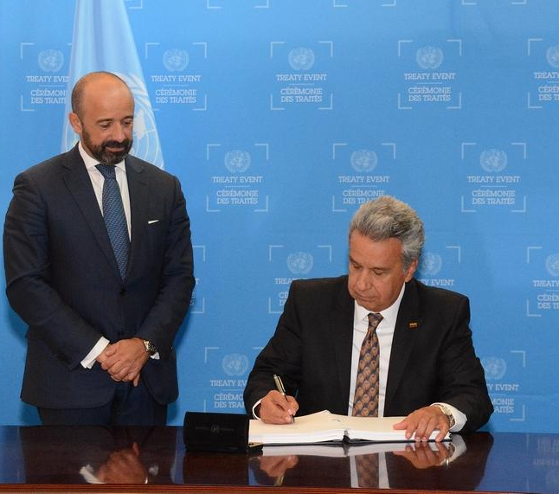
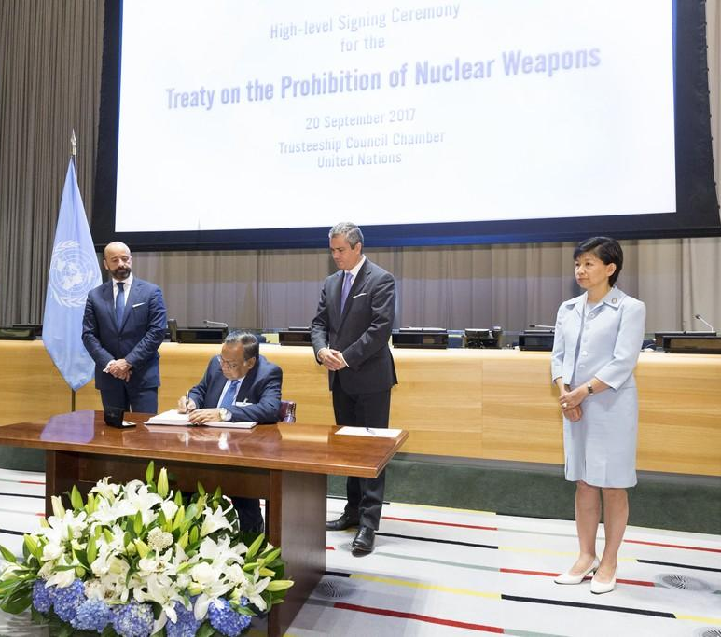
Bangladesh
H.E. Mr. Abul Hassan Mahmood Ali, Minister for Foreign Affairs
SIGNATURE
20 SEPTEMBER 2017

Slide 7
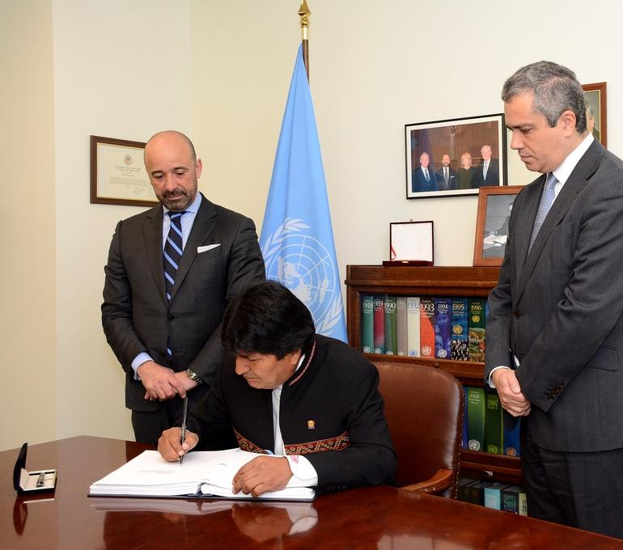
Bolivia
H.E. Mr. Evo Morales Ayma, Constitutional President
SIGNATURE
16 APRIL 2018

Slide 8
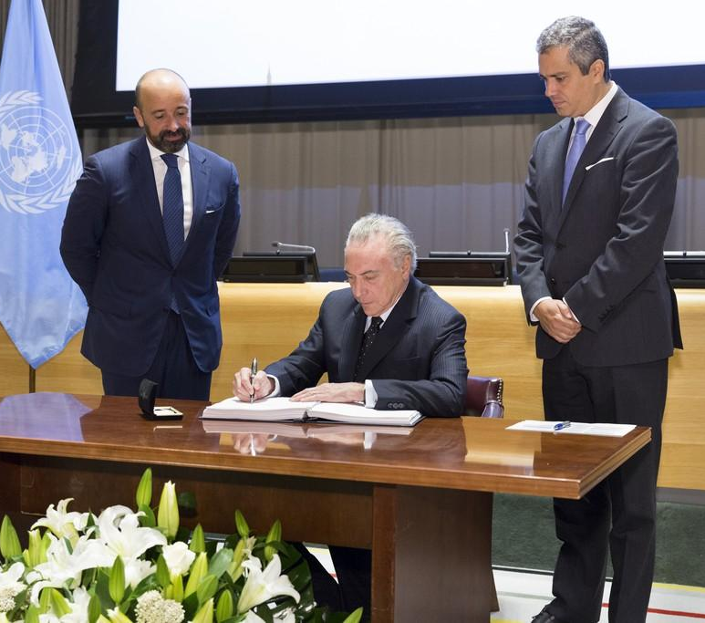
Brazil
H.E. Mr. Michel Temer, President
SIGNATURE
20 SEPTEMBER 2017

Slide 9
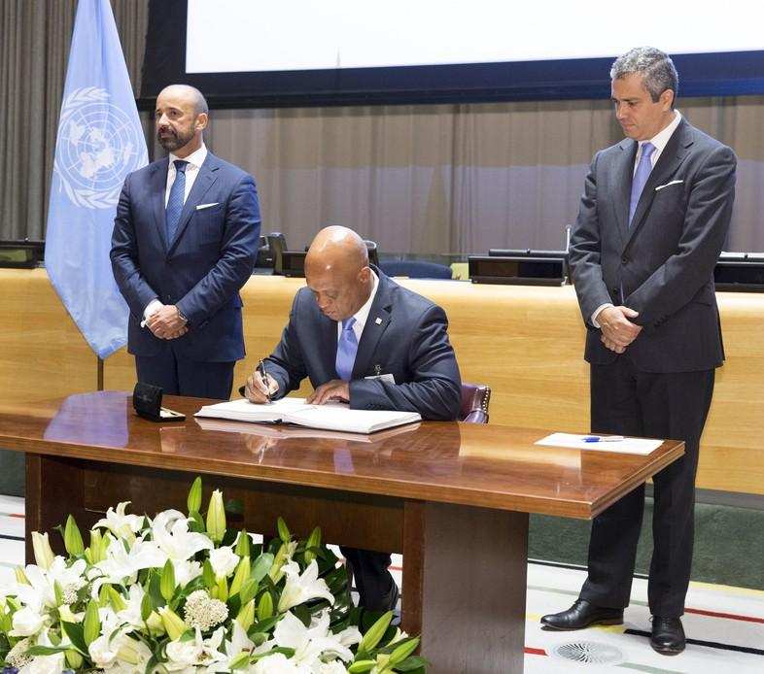
Cabo Verde
H.E. Mr. Luis Filipe Lopes Tavares, Minister for Foreign Affairs, Communities and Defense
SIGNATURE
20 SEPTEMBER 2017

Slide 10
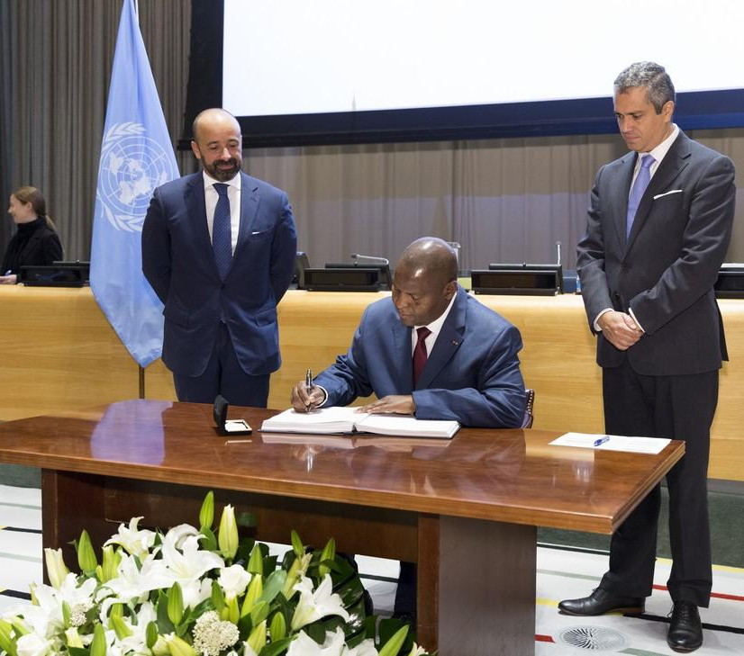
Central African Republic
H.E. Mr. Faustin Archange Touadera, President
SIGNATURE
20 SEPTEMBER 2017

Slide 11
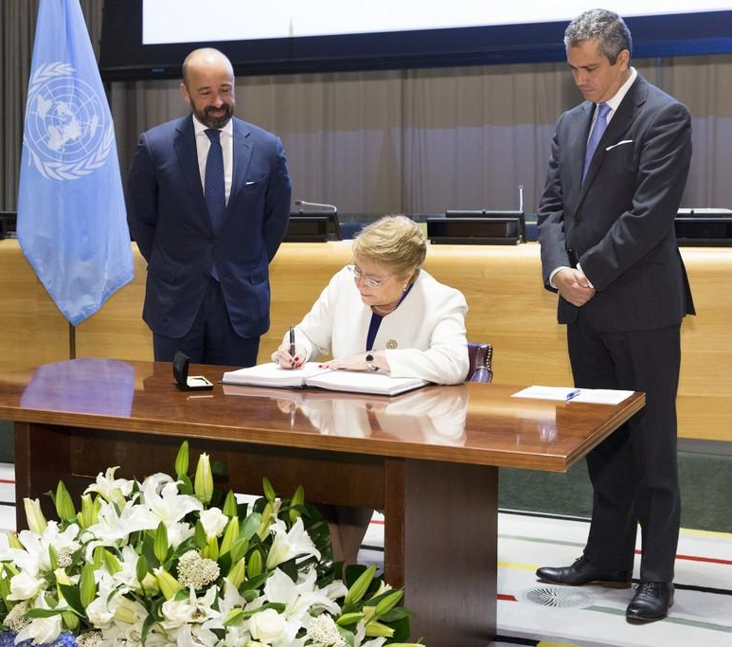
Chile
H.E. Ms. Michelle Bachelet Jeria, President
SIGNATURE
20 SEPTEMBER 2017

Slide 12
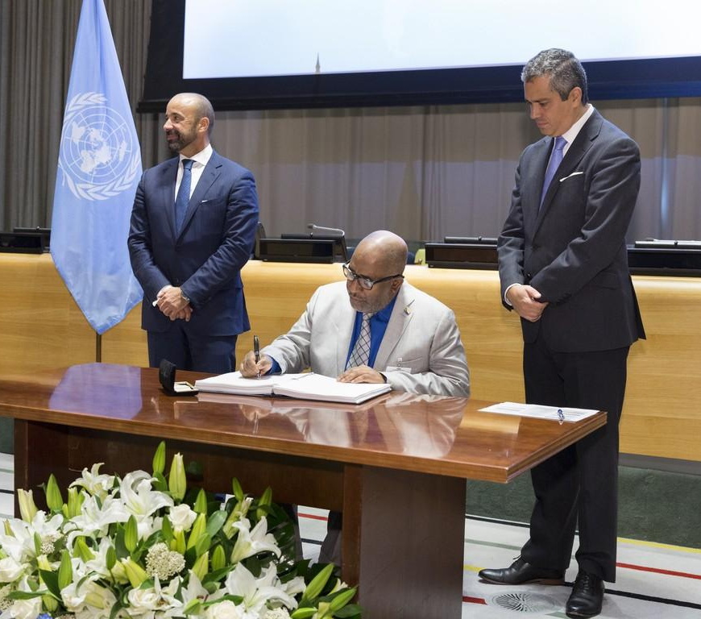
Comoros
H.E. Mr. Azali Assoumali, President
SIGNATURE
20 SEPTEMBER 2017

Slide 13
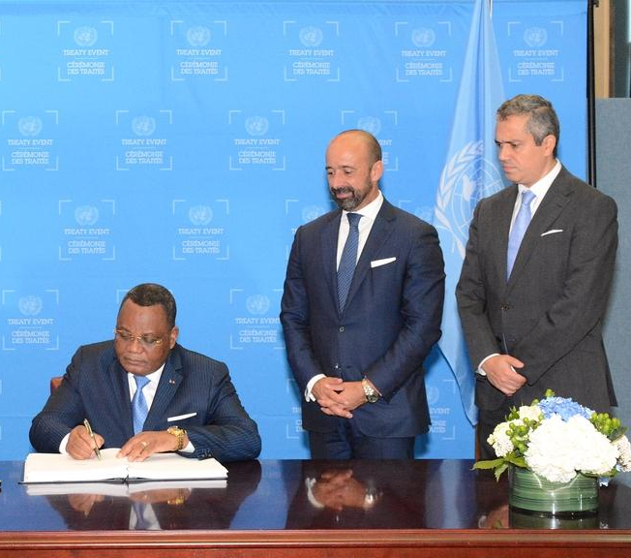
Republic of the Congo
H.E. Mr. Jean-Claude Gakosso, Minister of Foreign Affairs, Cooperation and Congolese Abroad
SIGNATURE
20 SEPTEMBER 2017

Slide 14
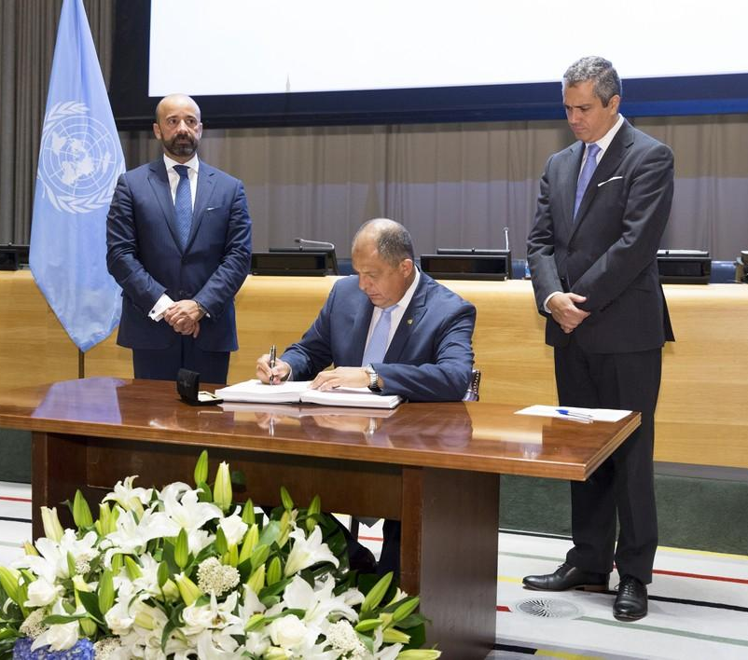
Costa Rica
Mr. Luis Guillermo Solís Rivera, President
SIGNATURE
20 SEPTEMBER 2017

Slide 15
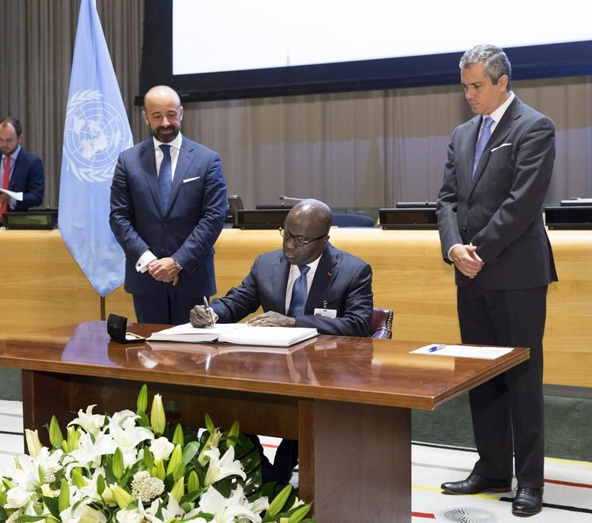
Côte d’Ivoire
H.E. Mr. Marcel Amon-Tanoh, Minister for Foreign Affairs
SIGNATURE
20 SEPTEMBER 2017

Slide 16
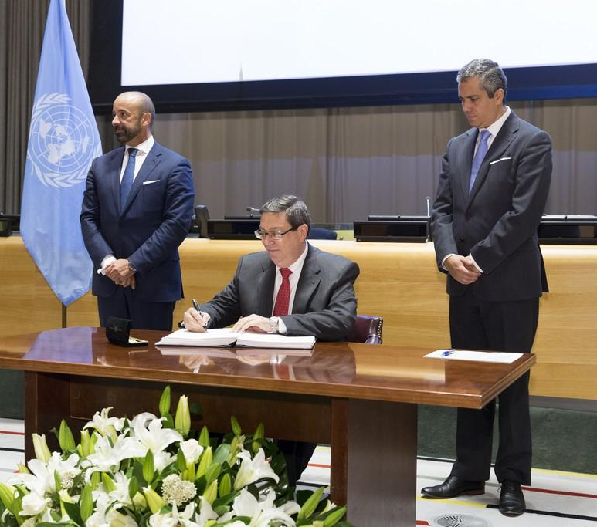
Cuba
H.E. Mr. Bruno Eduardo Rodríguez Parrilla, Minister for Foreign Affairs
SIGNATURE
20 SEPTEMBER 2017

Slide 17
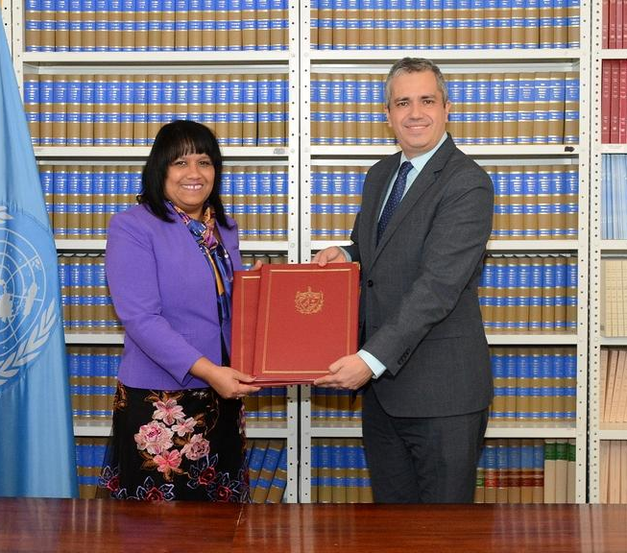
Cuba
H.E. Mrs. Anayansi Rodríguez Camejo, Permanent Representative to the United Nations
RATIFICATION
30 JANUARY 2018

Slide 18
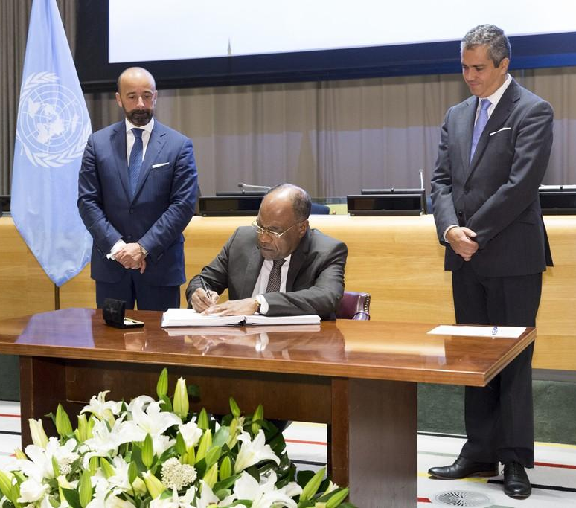
Democratic Republic of the Congo
H.E. Mr. Leonard She Okitundu, Vice-Prime Minister and Minister for Foreign Affairs
SIGNATURE
20 SEPTEMBER 2017

Slide 19
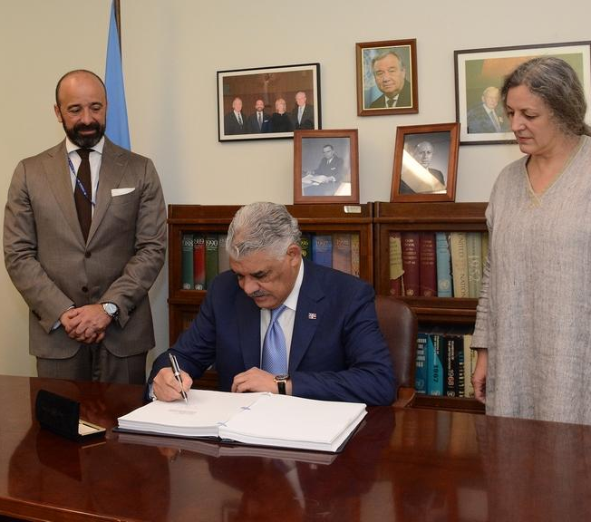
Dominican Republic
H.E. Mr. Miguel Vargas Maldonado, Minister of Foreign Affairs
SIGNATURE
7 JUNE 2018

Slide 20
Ecuador
H.E. Mr. Lenin Moreno Garcés, President
SIGNATURE
20 SEPTEMBER 2017

Slide 21
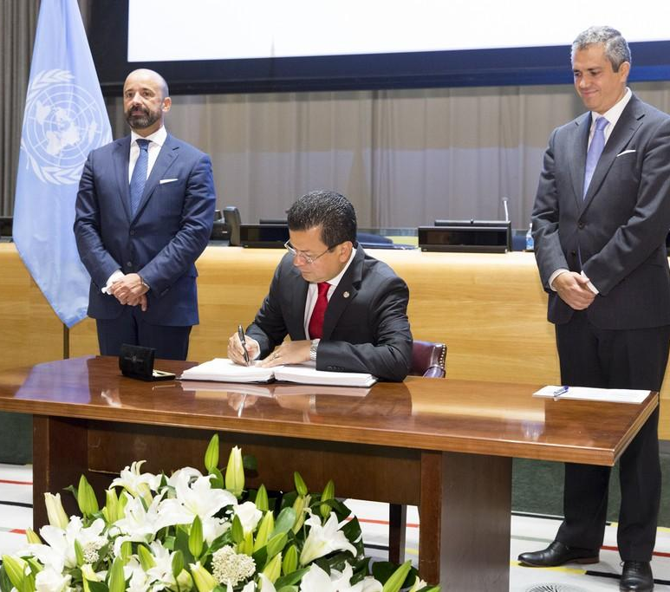
El Salvador
H.E. Mr. Hugo Roger Martínez Bonilla, Minister for Foreign Affairs
SIGNATURE
20 SEPTEMBER 2017

Slide 22
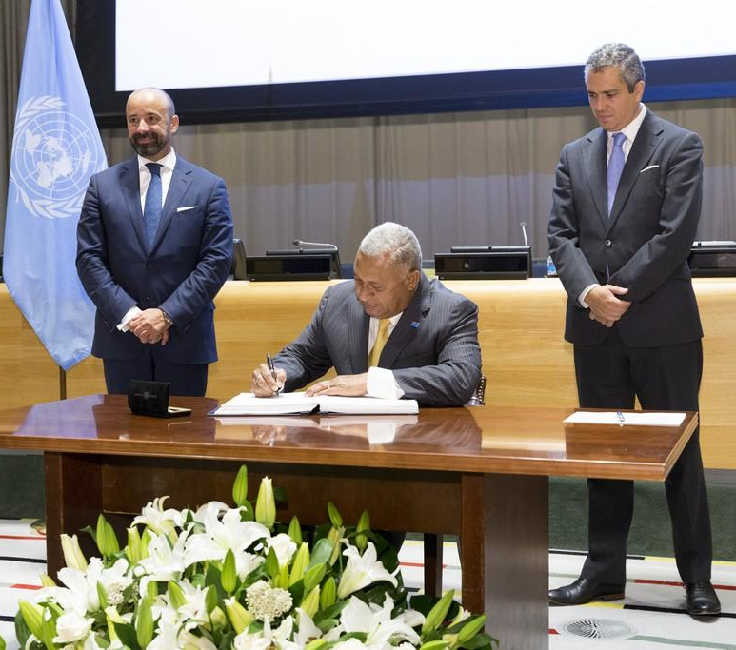
Fiji
H.E. Mr. Josaia Voreqe Bainimarama, Prime Minister
SIGNATURE
20 SEPTEMBER 2017

Slide 23
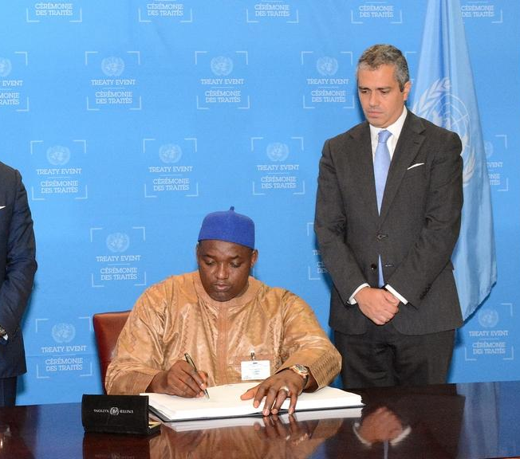
The Gambia
H.E. Mr. Adama Barrow, President
SIGNATURE
20 SEPTEMBER 2017

Slide 24
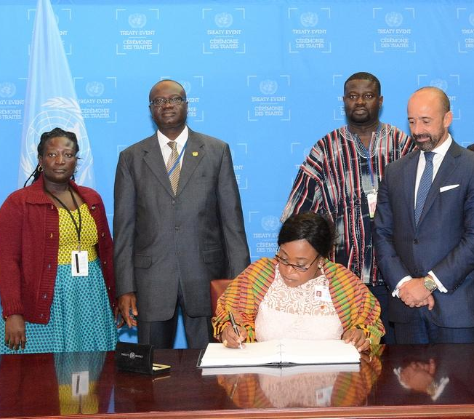
Ghana
H.E. Ms. Shirley Ayorkor Botchwey, Minister for Foreign Affairs and Regional Integration
SIGNATURE
20 SEPTEMBER 2017

Slide 25
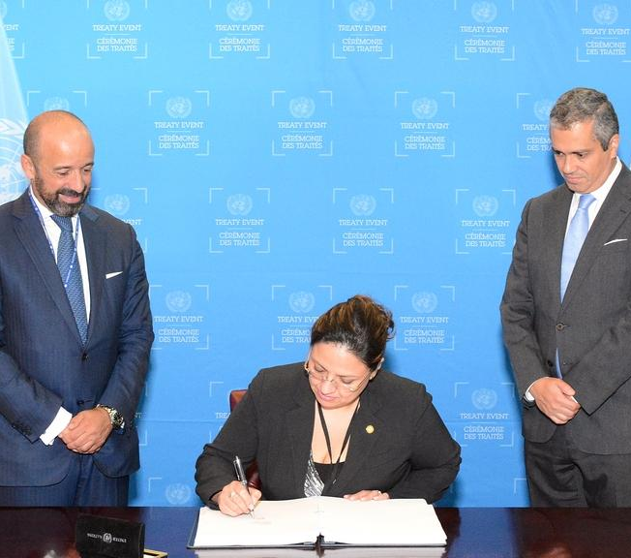
Guatemala
H.E. Ms. Sandra Erica Jovel Polanco, Minister of Foreign Affairs
SIGNATURE
20 SEPTEMBER 2017

Slide 26
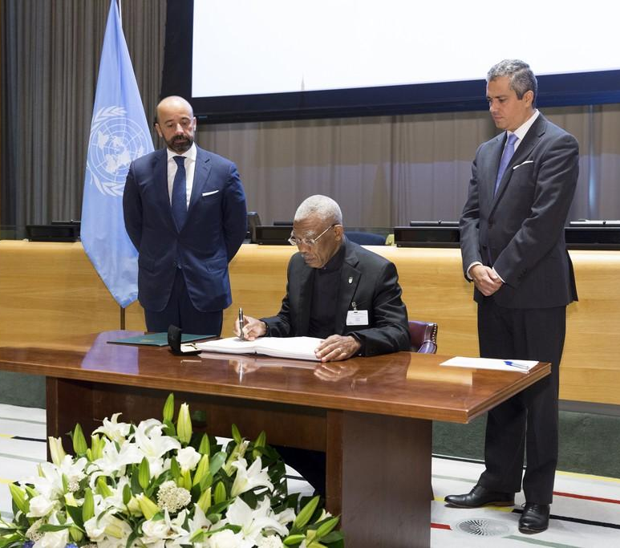
Guyana
H.E. Mr. David Arthur Granger, President
SIGNATURE
20 SEPTEMBER 2017

Slide 27
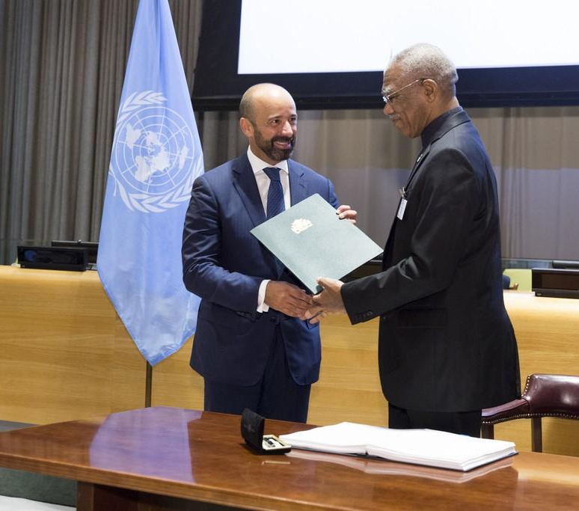
Guyana
H.E. Mr. David Arthur Granger, President
RATIFICATION
20 SEPTEMBER 2017

Slide 28
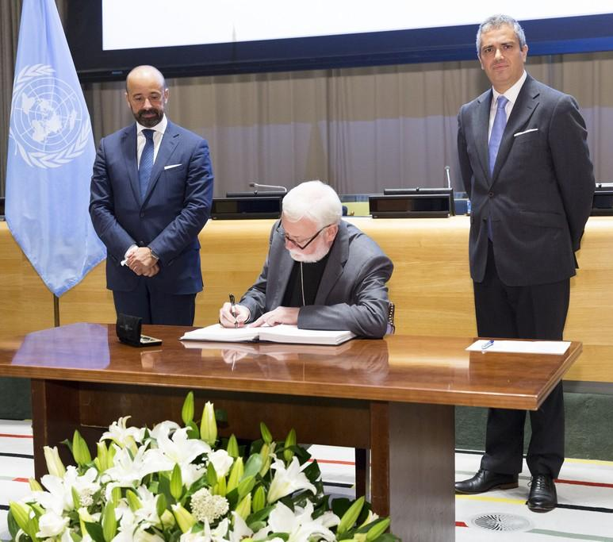
Holy See
Archbishop Paul Richard Gallagher, Secretary for Relations with States
SIGNATURE
20 SEPTEMBER 2017

Slide 29
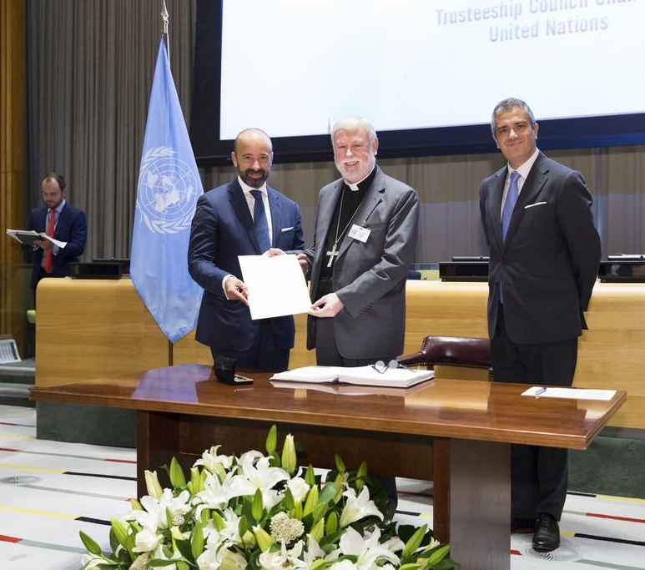
Holy See
Archbishop Paul Richard Gallagher, Secretary for Relations with States
RATIFICATION
20 SEPTEMBER 2017

Slide 30
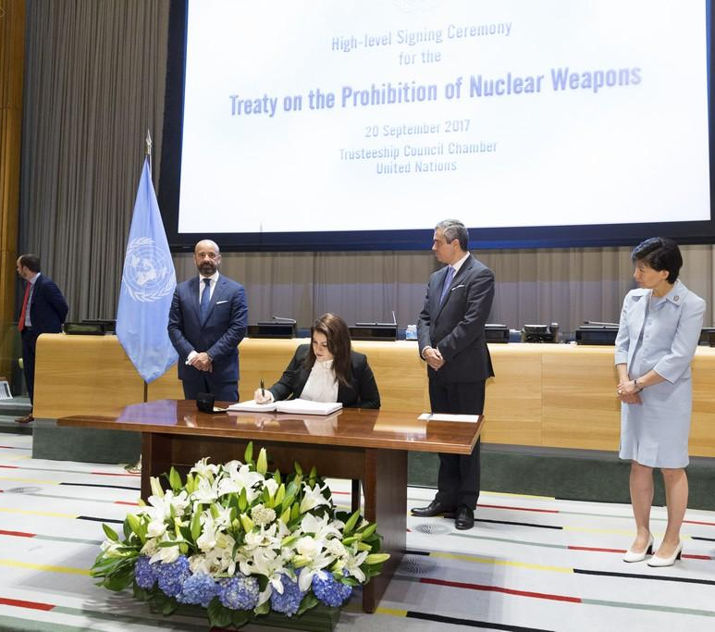
Honduras
H.E. Ms. Maria Dolores Aguero Lara, Minister for Foreign Affairs and International Cooperation
SIGNATURE
20 SEPTEMBER 2017

Slide 31
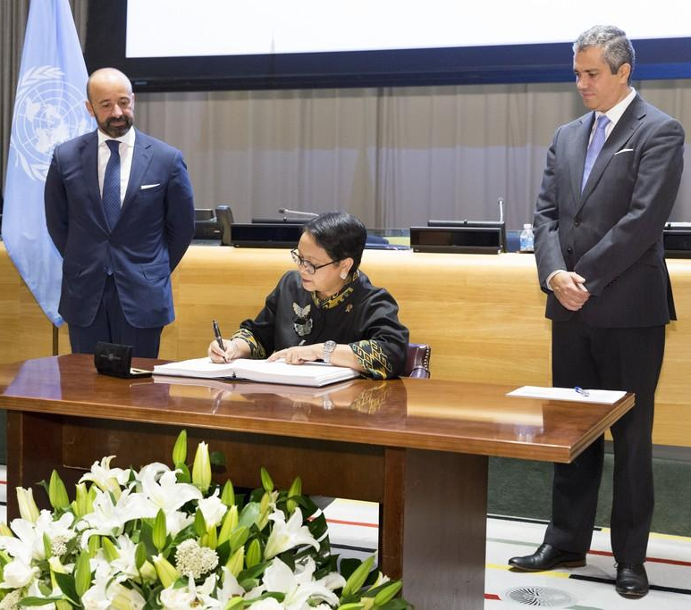
Indonesia
H.E. Mrs. Retno Lestari Priansari Marsudi, Minister for Foreign Affairs
SIGNATURE
20 SEPTEMBER 2017

Slide 32
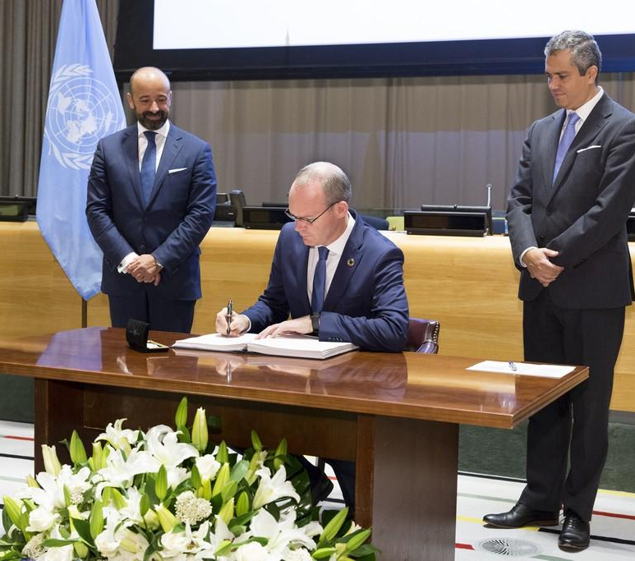
Ireland
H.E. Mr. Simon Coveney, Minister for Foreign Affairs
SIGNATURE
20 SEPTEMBER 2017

Slide 33
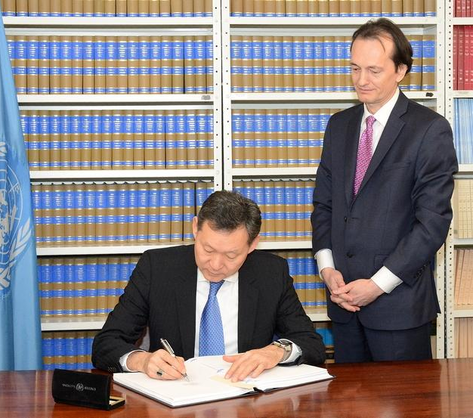
Kazakhstan
H.E. Mr. Kairat Umarov, Permanent Representative to the United Nations
SIGNATURE
2 MARCH 2018

Slide 34
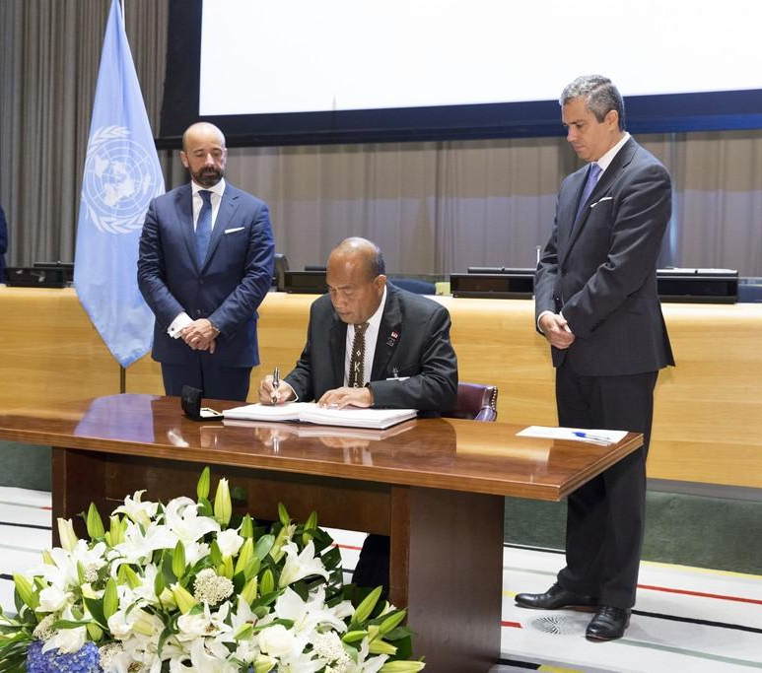
Kiribati
H.E. Mr. Taneti Maamau
President, Head of Government and Minister for Foreign Affairs and Immigration
SIGNATURE
20 SEPTEMBER 2017

Slide 35
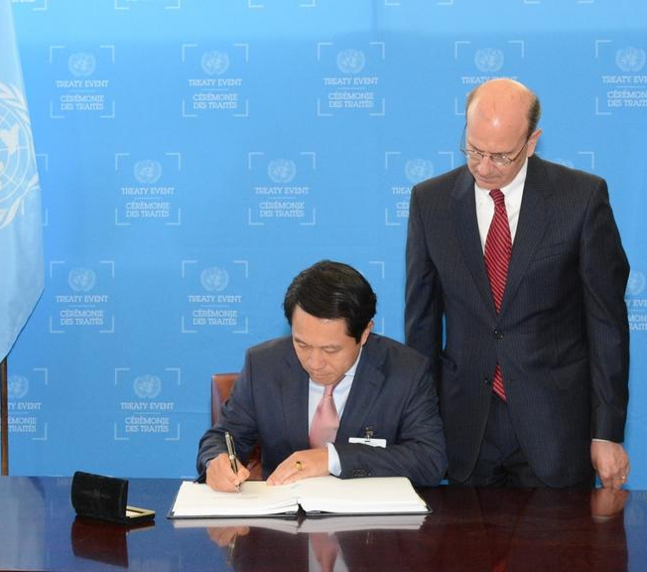
Laos
H.E. Mr. Saleumxay Kommasith, Minister for Foreign Affairs
SIGNATURE
21 SEPTEMBER 2017

Slide 36
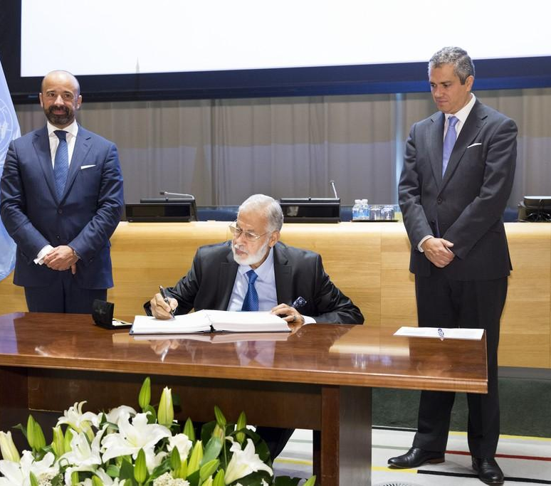
Libya
H.E. Mr. Mohamed T. H. Siala, Minister for Foreign Affairs and International Cooperation
SIGNATURE
20 SEPTEMBER 2017

Slide 37
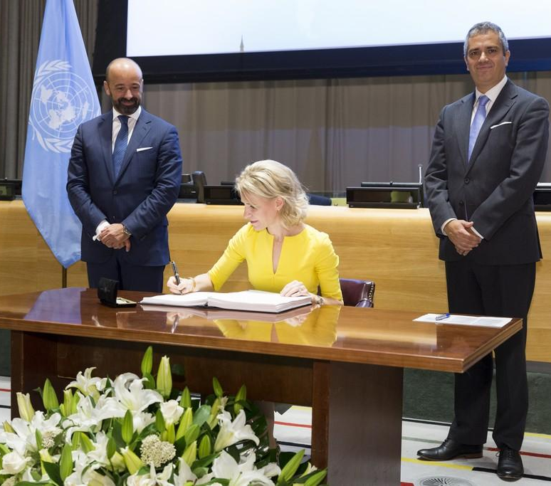
Liechtenstein
H.E. Ms. Aurelia Frick, Minister for Foreign Affairs
SIGNATURE
20 SEPTEMBER 2017

Slide 38
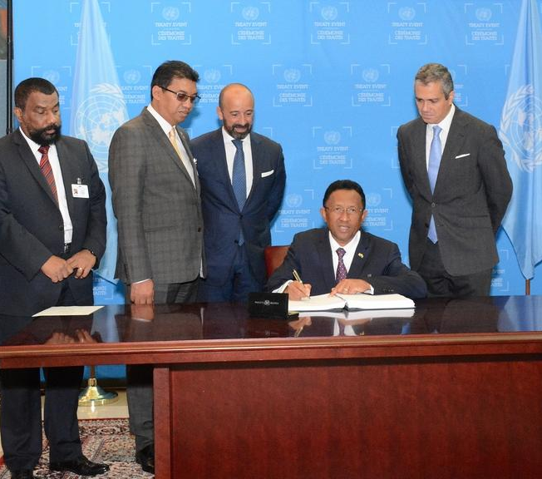
Madagascar
H.E. Mr. Hery Martial Rajaonarimampianina Rakotoarimanana, President
SIGNATURE
20 SEPTEMBER 2017

Slide 39
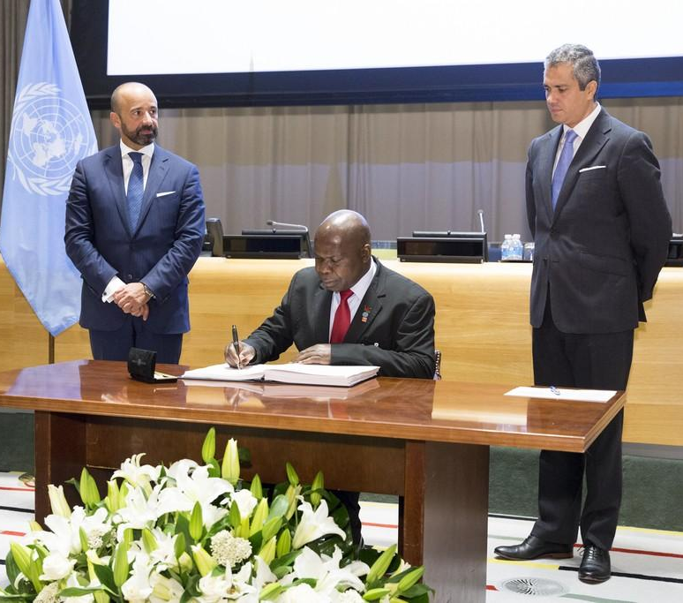
Malawi
H.E. Mr. Emmanuel Fabiano, Minister for Foreign Affairs and International Cooperation
SIGNATURE
20 SEPTEMBER 2017

Slide 40
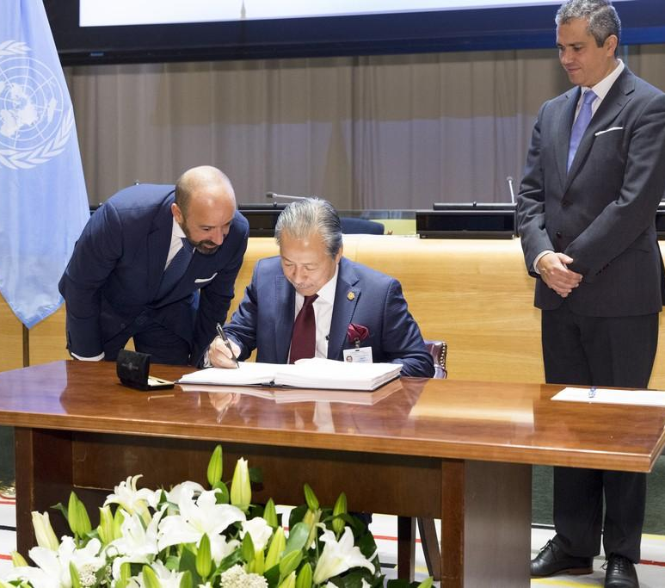
Malaysia
H.E. Mr. Dato Sri Anifah Aman, Minister for Foreign Affairs
SIGNATURE
20 SEPTEMBER 2017

Slide 41
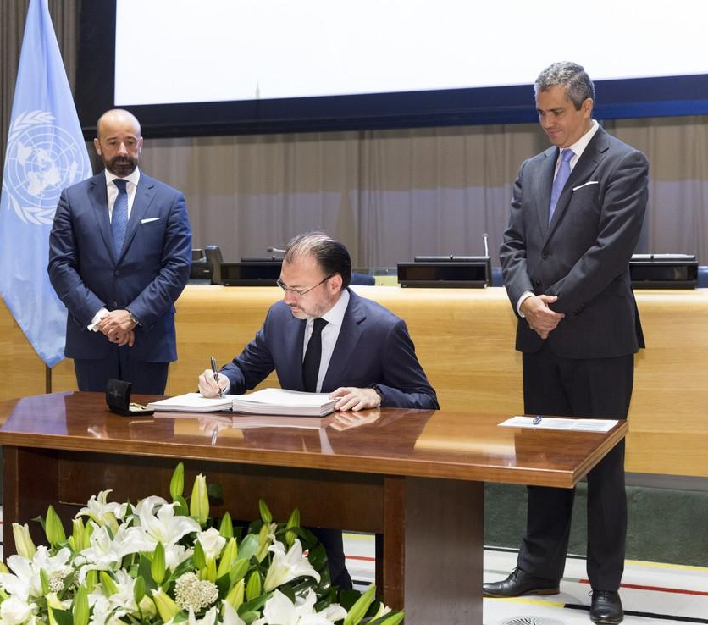
Mexico
H.E. Mr. Luis Videgaray Caso, Secretary of Foreign Affairs
SIGNATURE
20 SEPTEMBER 2017

Slide 42
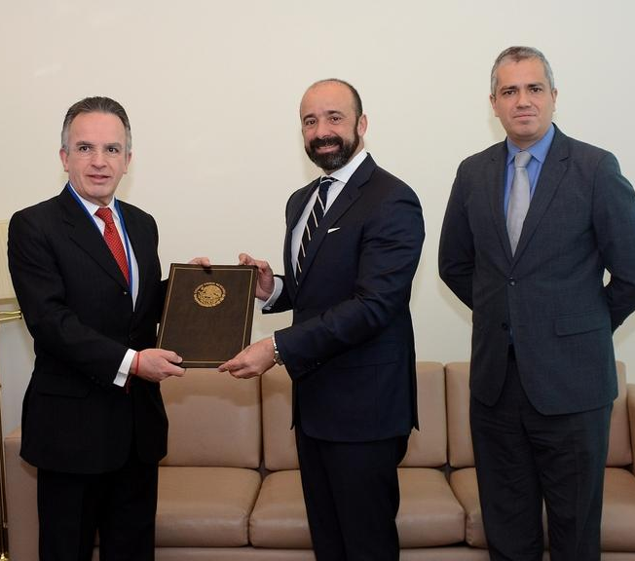
Mexico
H.E. Mr. Miguel Ruíz Cabañas, Ambassador, Assistant Secretary for Multilateral Affairs and Human Rights
RATIFICATION
16 JANUARY 2018

Slide 43
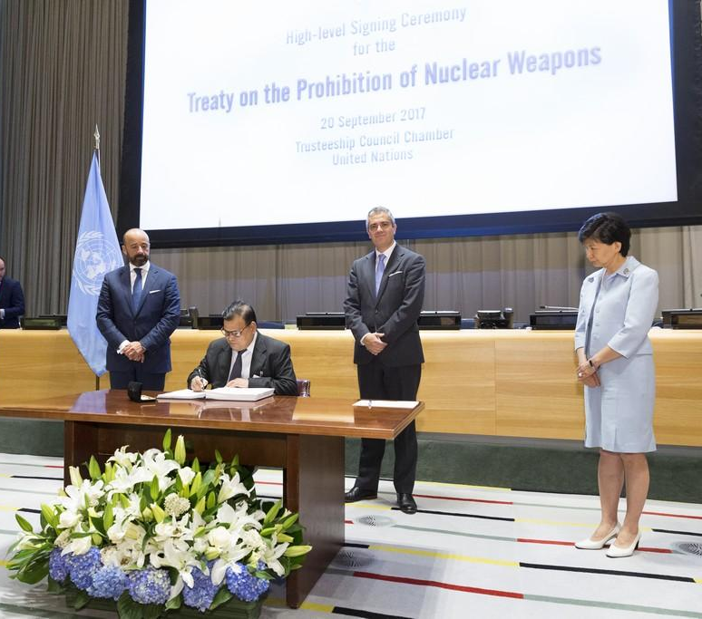
Nepal
H.E. Mr. Krishna Bahadur Mahara, Minister for Foreign Affairs
SIGNATURE
20 SEPTEMBER 2017

Slide 44
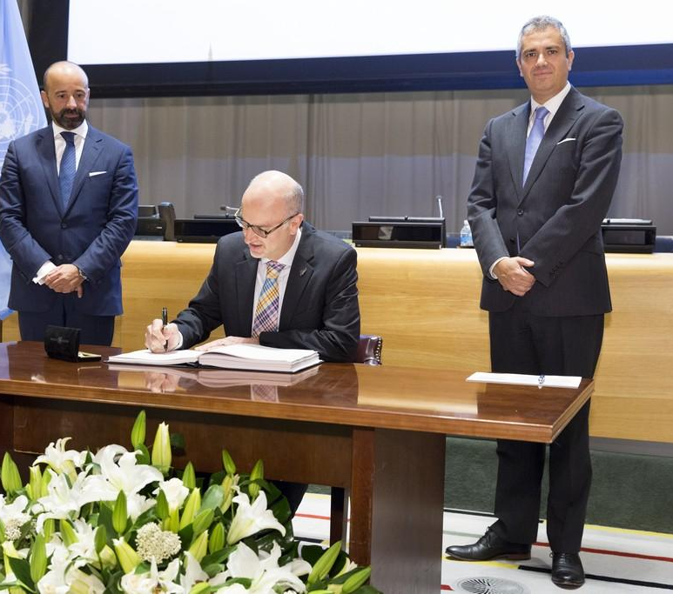
New Zealand
H.E. Mr. Craig Hawke, Permanent Representative to the United Nations
SIGNATURE
20 SEPTEMBER 2017

Slide 45
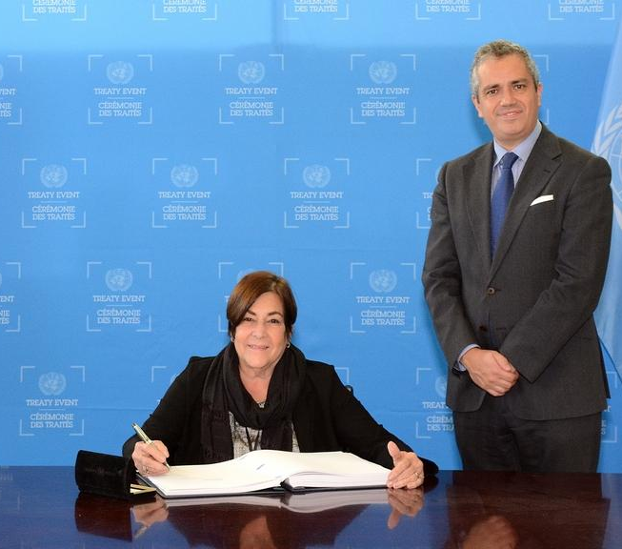
Nicaragua
H.E. Ms. Maria Rubiales de Chamorro, Vice Minister of Foreign Affairs
SIGNATURE
22 SEPTEMBER 2017

Slide 46
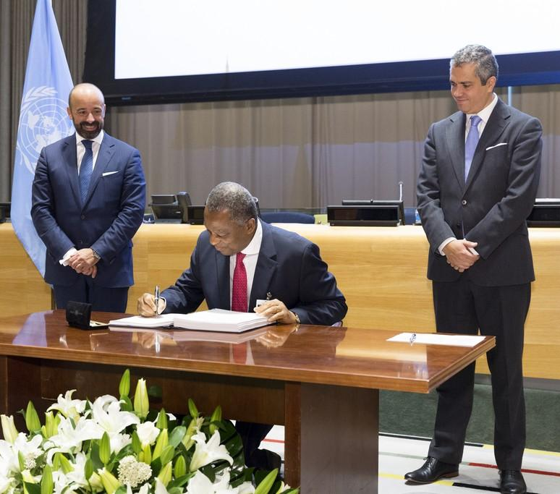
Nigeria
H.E. Mr. Geoffrey Onyeama, Minister for Foreign Affairs
SIGNATURE
20 SEPTEMBER 2017

Slide 47
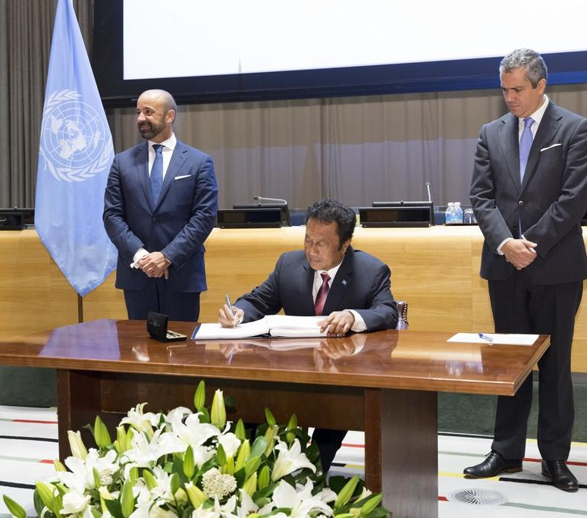
Palau
H.E. Mr. Tommy Esang Remengesau, President
SIGNATURE
20 SEPTEMBER 2017
RATIFICATION
3 MAY 2018

Slide 48
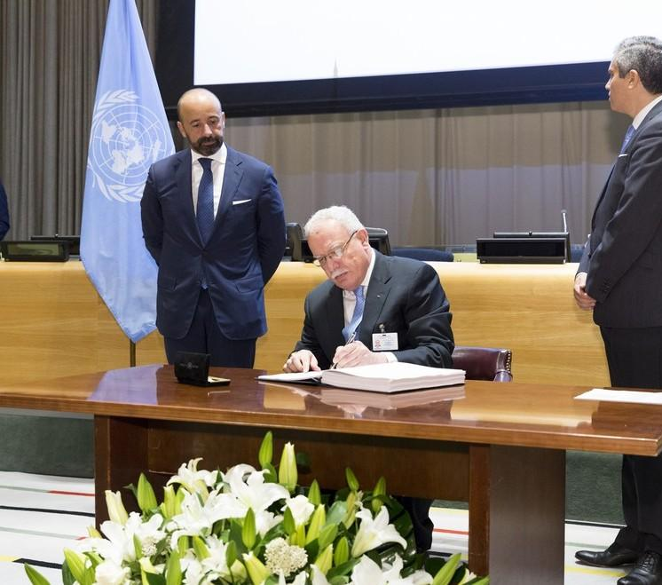
Palestine
H.E. Mr. Riad Al-Malki, Minister for Foreign Affairs
SIGNATURE
20 SEPTEMBER 2017
RATIFICATION
22 MARCH 2018

Slide 49
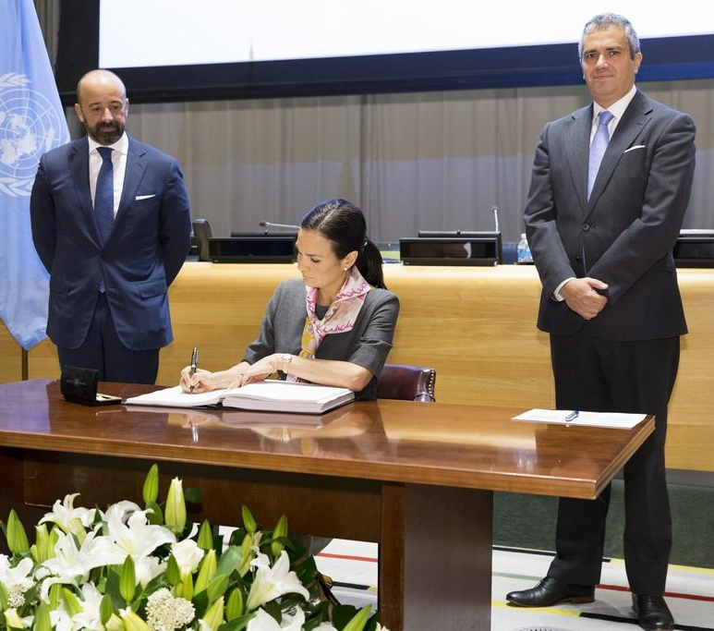
Panama
H.E. Ms. Isabel de Saint Malo de Alvarado, Vice-President and Minister for Foreign Affairs
SIGNATURE
20 SEPTEMBER 2017

Slide 50
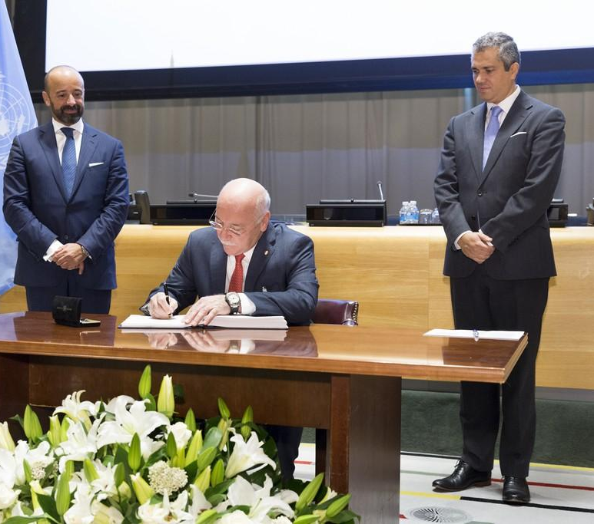
Paraguay
H.E. Mr. Eladio Ramón Loizaga Lezcano, Minister for Foreign Affairs
SIGNATURE
20 SEPTEMBER 2017

Slide 51
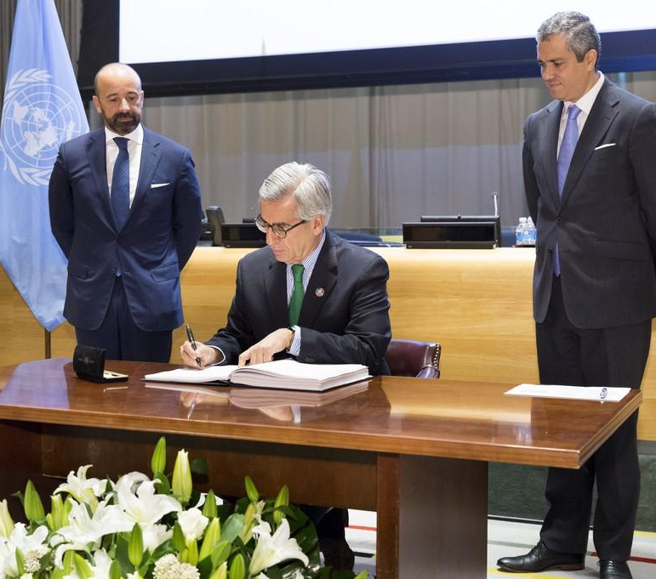
Peru
H.E. Mr. Antonio Javier Alejandro García Revilla, Director General of Multilateral and Global Affairs of the Ministry of Foreign Affairs
SIGNATURE
20 SEPTEMBER 2017

Slide 52
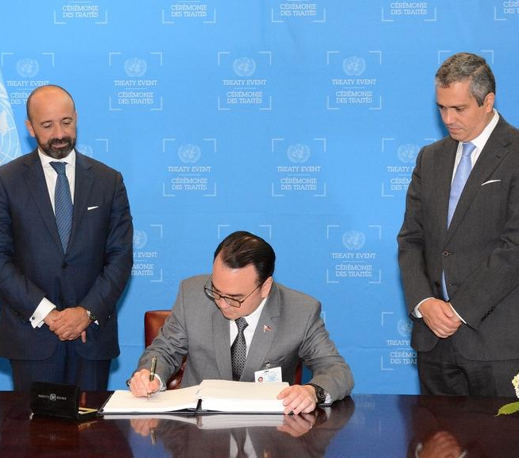
Philippines
H.E. Mr. Alan Peter S. Cayetano, Secretary for Foreign Affairs
SIGNATURE
20 SEPTEMBER 2017

Slide 53

St Vincent & Grenadines
H.E. Ms. Inga Rhonda King, Permanent Representative to the United Nations
SIGNATURE
8 DECEMBER 2017

Slide 54

Samoa
H.E. Mr. Tuila’epa Sailele Malielegaoi, Prime Minister and Minister for Foreign Affairs
SIGNATURE
20 SEPTEMBER 2017

Slide 55

San Marino
H.E. Mr. Nicola Renzi, Minister for Foreign and Political Affairs
SIGNATURE
20 SEPTEMBER 2017

Slide 56

São Tomé
& Príncipe
H.E. Mr. Urbino José Gonçalves Botelho, Minister for Foreign Affairs and Communities
SIGNATURE
20 SEPTEMBER 2017

Slide 57

South Africa
H.E. Mr. Jacob Zuma, President
SIGNATURE
20 SEPTEMBER 2017

Slide 58

Thailand
H.E. Mr. Don Pramudwinai, Minister for Foreign Affairs
SIGNATURE
20 SEPTEMBER 2017

Slide 59

Thailand
H.E. Mr. Don Pramudwinai, Minister for Foreign Affairs
RATIFICATION
20 SEPTEMBER 2017

Slide 60

Togo
H.E. Mr. Robert Dussey
Minister of State, Minister for Foreign Affairs, Cooperation and African Integration
SIGNATURE
20 SEPTEMBER 2017

Slide 61

Tuvalu
H.E. Mr. Enele Sosene Sopoaga, Prime Minister
SIGNATURE
20 SEPTEMBER 2017

Slide 62

Uruguay
H.E. Mr. Elbio Rosselli, Permanent Representative to the United Nations
SIGNATURE
20 SEPTEMBER 2017

Slide 63

Vanuatu
H.E. Mr. Bruno Leingkone, Minister for Foreign Affairs, International Cooperation and External Trade
SIGNATURE
20 SEPTEMBER 2017

Slide 64

Venezuela
H.E. Mr. Jorge Arreaza, Minister for Foreign Affairs
SIGNATURE
20 SEPTEMBER 2017

Slide 65

Venezuela
H.E. Mr. Samuel Moncada, Permanent Representative to the United Nations
RATIFICATION
27 MARCH 2018

Slide 66

Viet Nam
H.E. Mr. Pham Binh Minh, Deputy Prime Minister and Minister for Foreign Affairs
SIGNATURE
22 SEPTEMBER 2017

Slide 67

Viet Nam
H.E. Mrs. Nguyen Phuong Nga, Permanent Representative to the United Nations
RATIFICATION
17 MAY 2018

Slide 68
Images courtesy of the UN Office of Legal Affairs

